Slide 1

Quantum Computing and an example in Q#
J. Bohl
January 13, 2018

Slide 2
Agenda
1
What is a Quantum Computer?
2
Q#
3
Grover‘s algorithm
4
4-bit adder
5
6
7
8

Slide 3
Agenda
1
What is a Quantum Computer?
2
Q#
3
Grover‘s algorithm
4
4-bit adder
5
6
7
8

Slide 4
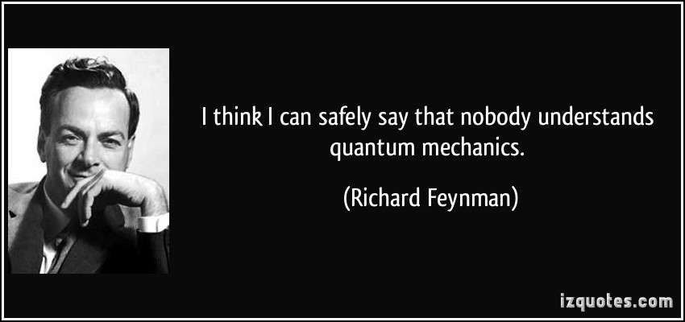
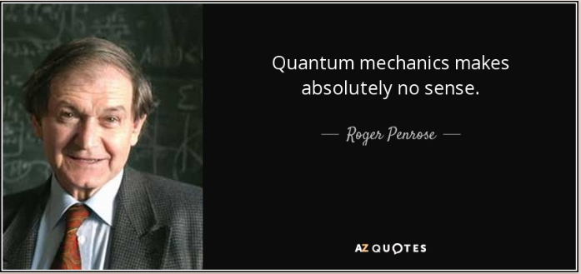

Slide 5
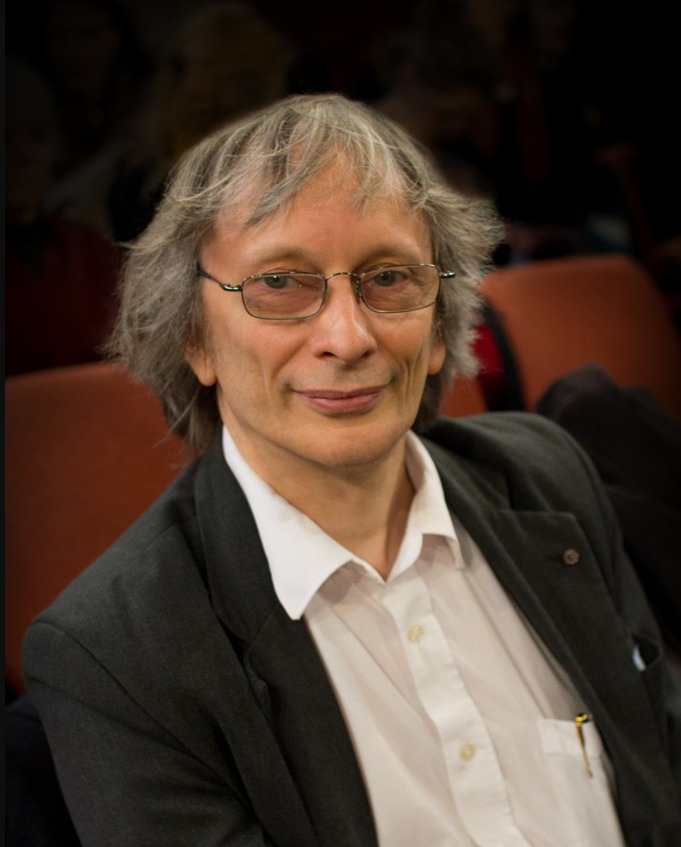
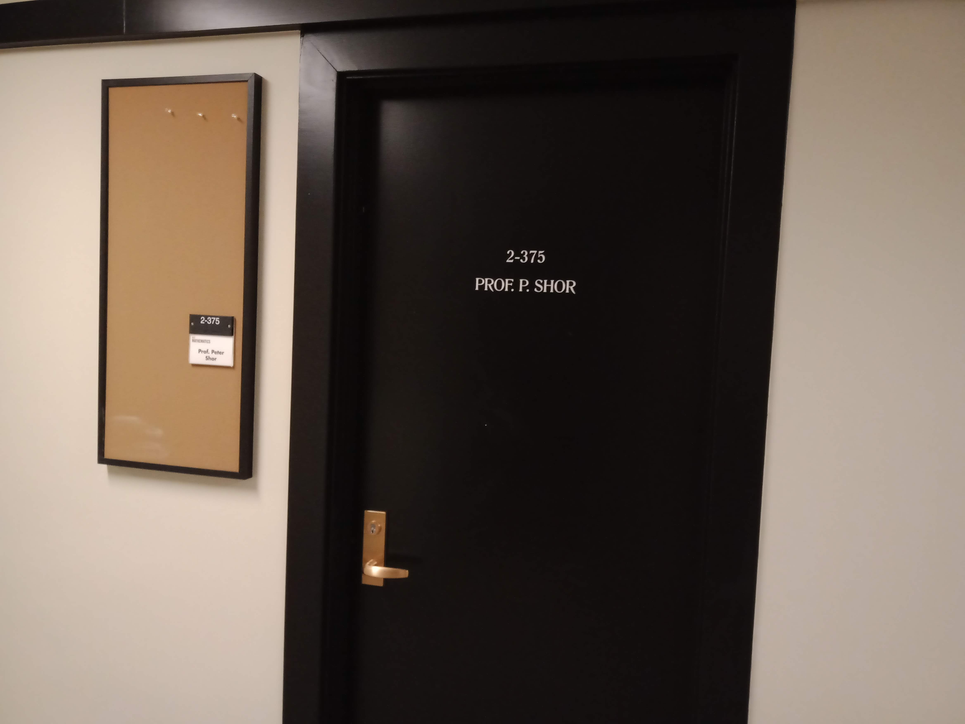
history
Year
1982 | Feynman proposed the idea of creating machines based on the laws of quantum mechanics instead of the laws of classical physics
1985 | David Deutsch developed the Quantum Turing Machine, showing that quantum circuits are universal
1994 | Peter Shor came up with a quantum algorithm to factor very large numbers in polynomial time
1997 | Lov Grover develops a quantum search algorithm with O(√N) complexity
2001 | Researchers built a 7 qubit machine and programmed it to run Shor’s algorithm to successfully factor 15
https://en.wikipedia.org/wiki/Timeline_of_quantum_computing

Slide 6
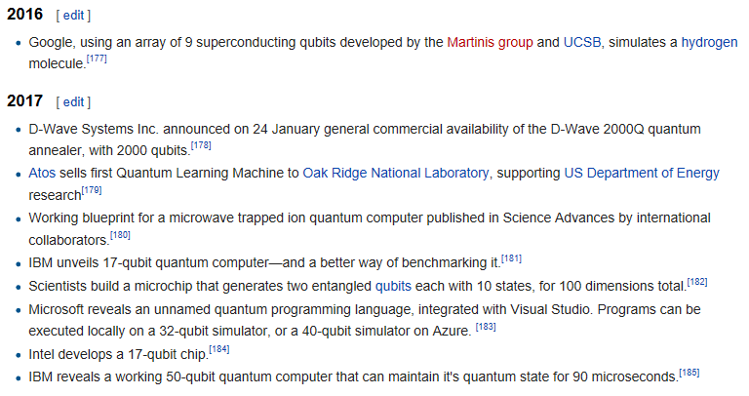
→ https://en.wikipedia.org/wiki/Timeline_of_quantum_computing_and_communication

Slide 7
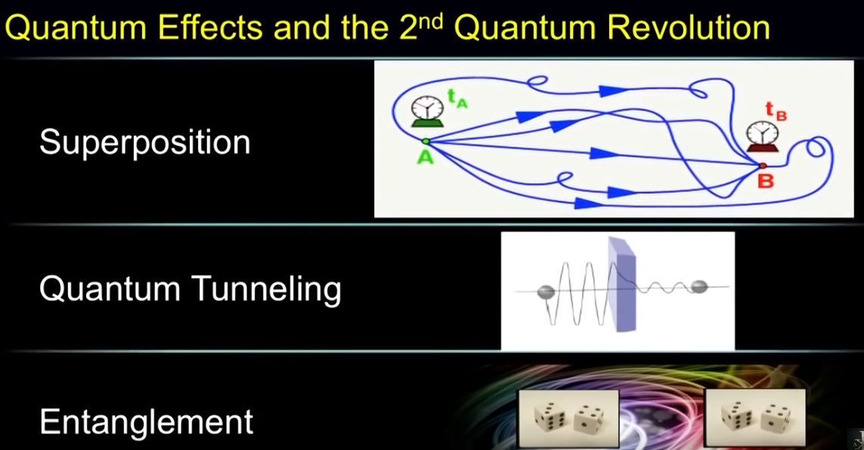
https://www.youtube.com/watch?v=JKhrDgpX_mc

Slide 8
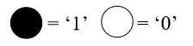
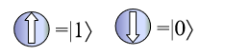
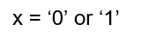
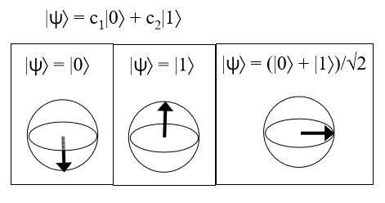
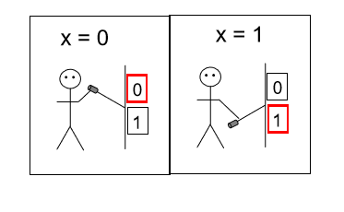
Classical computation vs Quantum Computation
Classical Computation
Data unit: bit
Valid states:
Quantum Computation
Data unit: qubit
Valid states:

Slide 9
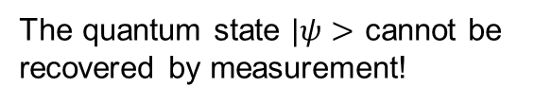
Superposition
A single qubit can be in in a superposition of the two states
where α₁ and α₂ are complex numbers.
The quantum state $|ψ>$ cannot be recovered by measurement!

Slide 10
Superposition
Classical Computation
Measurement: deterministic
Quantum Computation
Measurement: stochastic
State | Result of measurement
State | Result of measurement

Slide 11
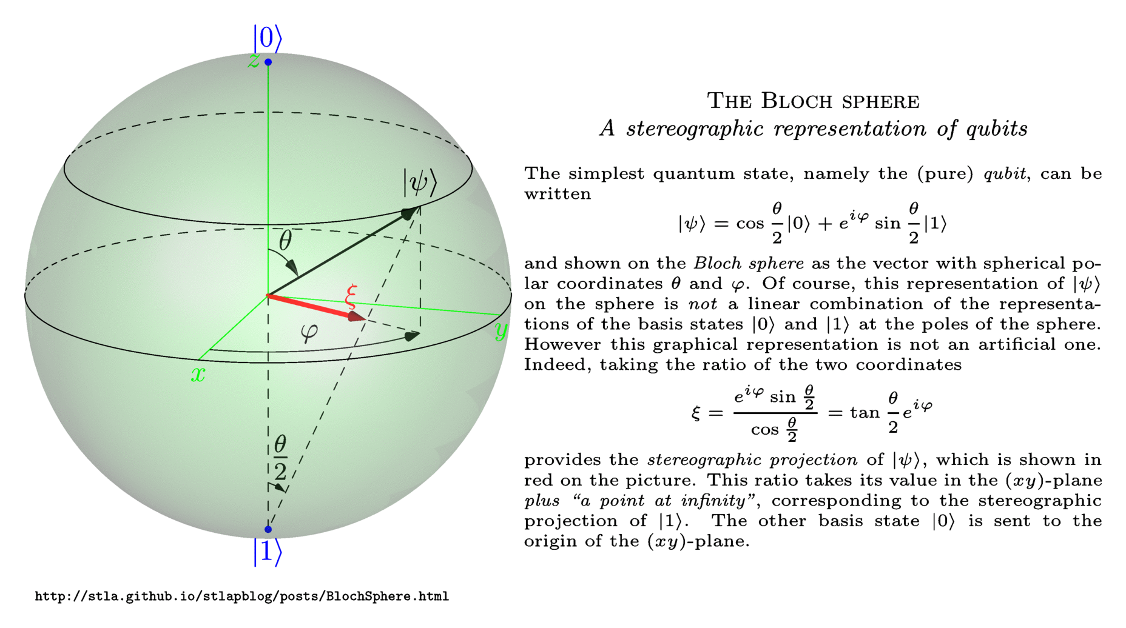
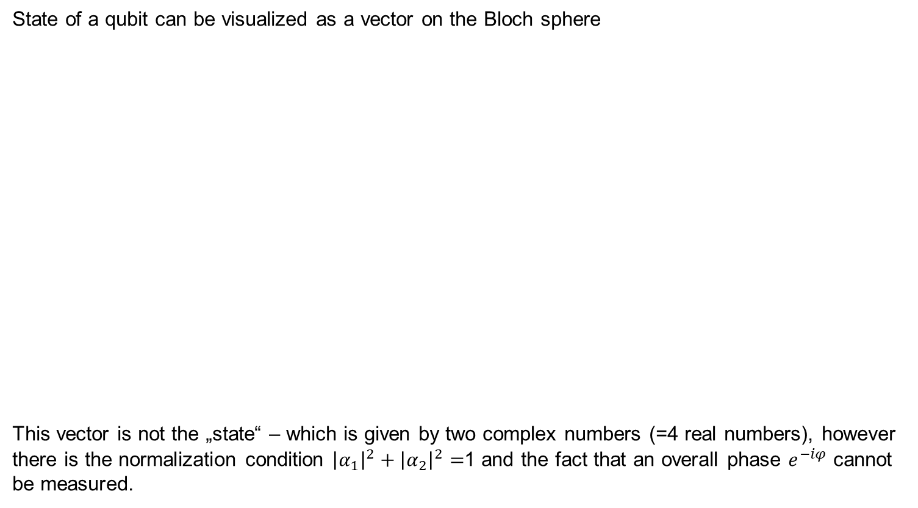
Superposition
State of a qubit can be visualized as a vector on the Bloch sphere
This vector is not the „state“ – which is given by two complex numbers (=4 real numbers), however there is the normalization condition ${\left|α_{1}\right|}^{2}+{\left|α_{2}\right|}^{2}=$1 and the fact that an overall phase $e^{−iφ}$ cannot be measured.

Slide 12
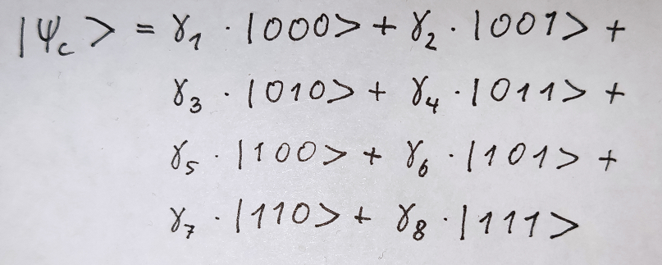
Entanglement
If two quantum system get into interaction, they get into entanglement. Entanglement has no classic analogon. It means something like… the state of the two system cannot described with two distinct objects, instead we have combined state (and superposition of the „combined state“).
(in order to describe the system)

Slide 13
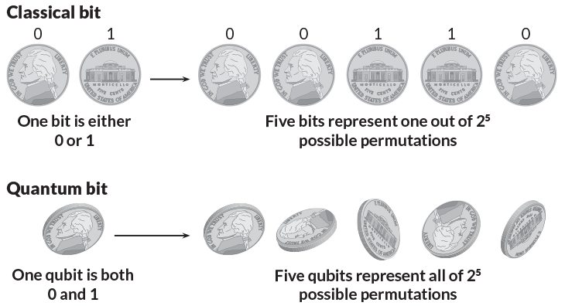
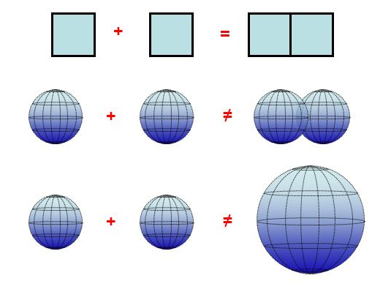
Entanglement
In a sense, n classical bits give us one state out of $2^{n}$ possible states, whereas n Qubits give use all $2^{n}$ states at once.

Slide 14
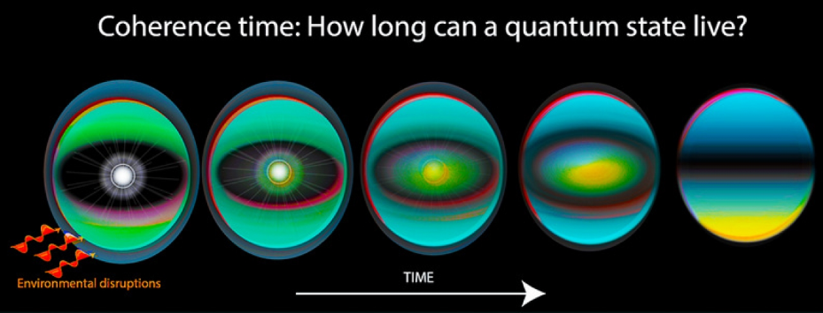
Decoherence
Practical problem with entangled Qubits – if they get into interaction with the (macroscopic) environment, the superposition is lost, the state is collapsed to one of the classical states.
→ Qubits must be isolated from the rest of the universe, and that‘s one of the fundamental challenges in building a Quantum Computer.

Slide 15
Decoherence
Practical problem with entangled Qubits – if they get into interaction with the (macroscopic) environment, the superposition is lost, the state is collapsed to one of the classical states.
→ Qubits must be isolated from the rest of the universe, and that‘s one of the fundamental challenges in building a Quantum Computer.

Slide 16
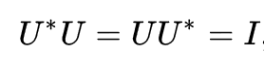
Gates
A Quantum Gate is a circuit working on one or more Qubits – which are allowed by the laws of quantum mechanics.
QM requires that the operations can be described as Unitary transformations.
Unitary Matrix: a complex square matrix U is unitary if the conjugate transposed matrix U* is the inverse:
→ Quantum Gates are reversible = the input state can be derived uniquely from their output state

Slide 17
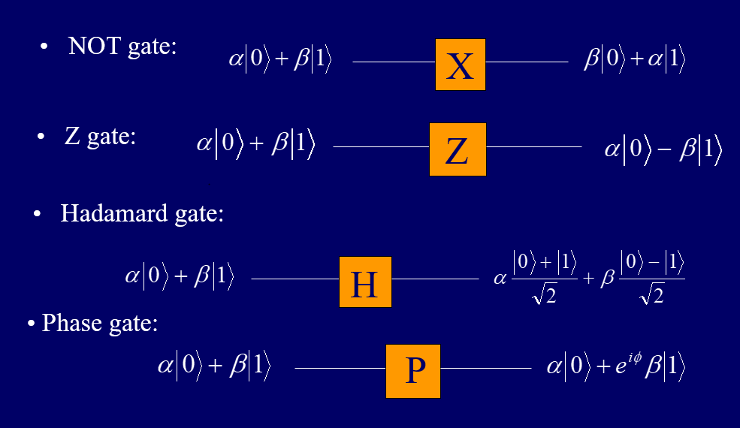
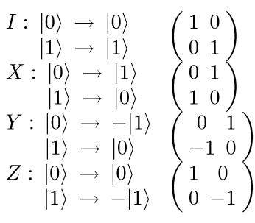
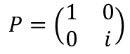
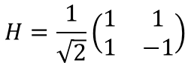
Single Qubit Gates
$$H=\frac{1}{\sqrt{2}}\left(\begin{matrix}1 & 1 \\ 1 & −1\end{matrix}\right)$$
https://en.wikipedia.org/wiki/Quantum_logic_gate https://youtu.be/hgdZ1Vc013Y
$$P=\left(\begin{matrix}1 & 0 \\ 0 & i\end{matrix}\right)$$

Slide 18
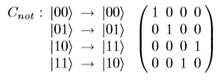
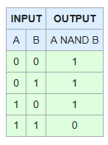
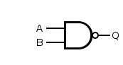
Multiple Qubit Gates
Controlled-Not (CNOT) – if bit on the control line is 1, invert the bit on the target line
For example, the classical NAND-Gate is not unitary:
Classical Computing Theorem: any function on bits can be computed by a composition of NAND-gates alone
Quantum Computing Theorem: any function on qubits can be done by a composition of CNOT-gates and single qubit gates
Control
Target

Slide 19
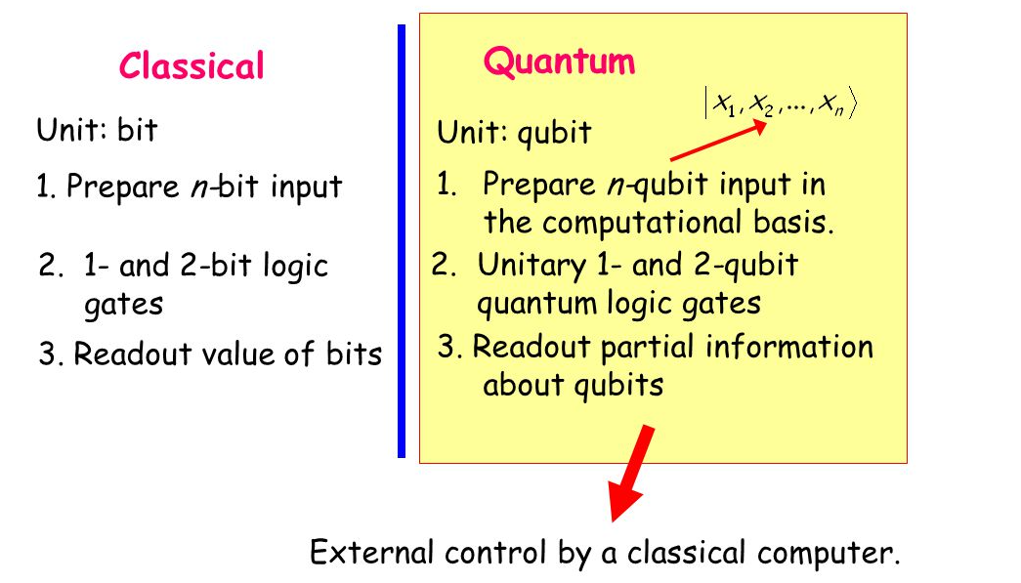
Quantum circuit model

Slide 20
Agenda
1
What is a Quantum Computer?
2
Q#
3
Grover‘s algorithm
4
4-bit adder
5
6
7
8

Slide 21
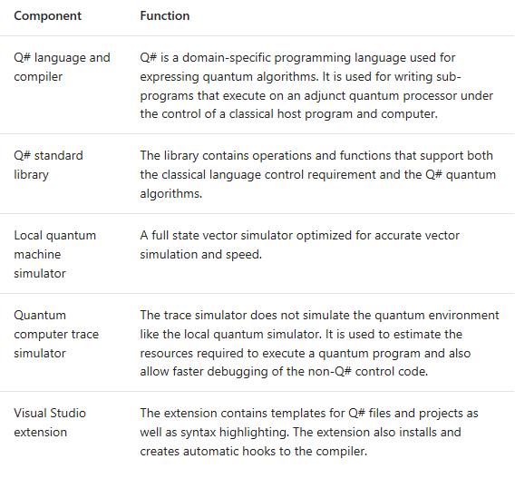
Q#
It comes as a shrink-wrapped VisualStudio-extension and NuGet-packages → https://docs.microsoft.com/en-us/quantum/quickstarts/
+ Python APIs
+ IQ# Jupyter kernel
+ online environments with codespaces, Binder or Docker https://docs.microsoft.com/en-us/quantum/quickstarts/install-binder
https://aka.ms/try-qsharp

Slide 22
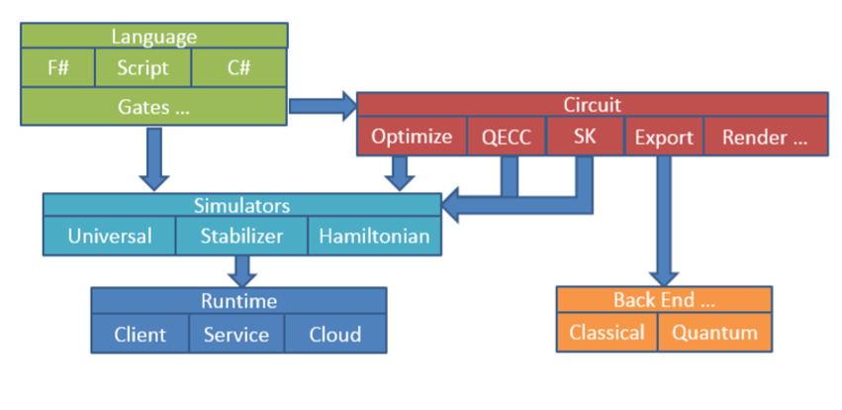
Q#
https://docs.microsoft.com/en-us/quantum/index?view=qsharp-preview http://stationq.github.io/Liquid/docs/LIQUiD.pdf
Q# is derives from a project of Microsoft Research LIQ𝑈𝑖|⟩ http://stationq.github.io/Liquid/

Slide 23
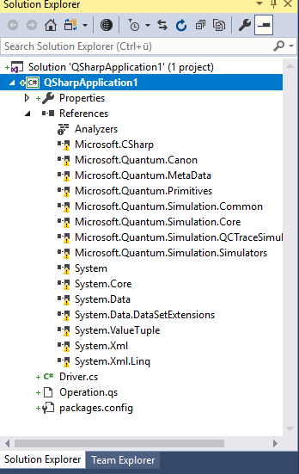
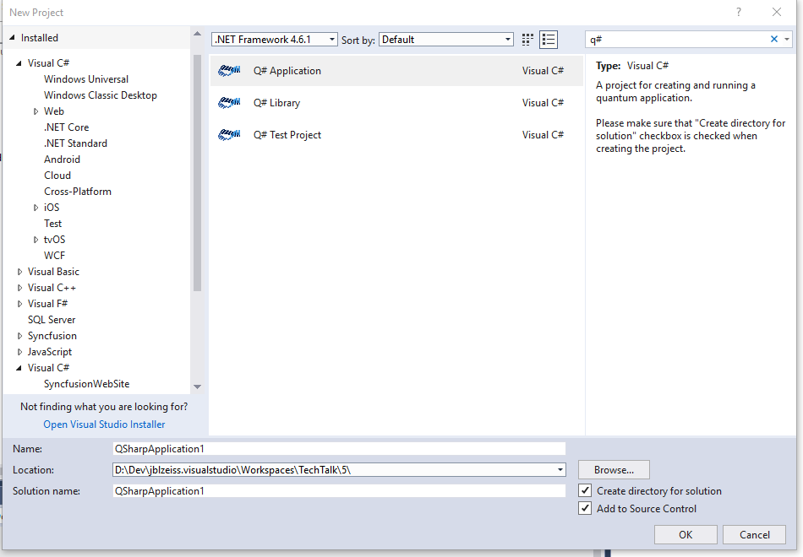
Q#

Slide 24
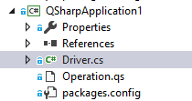
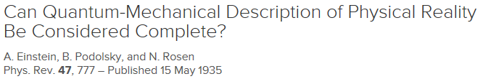
Q#
Demo
Prepare one qubit in a pure state |0> or |1> and then measure it
Prepare two qubits in superposition (not entangled!) and measure them
Prepare two qubits in superposition, apply a CNOT-gate to bring them in entanglement, then measure them → whenever we measure qubit 1 in state |0>, then qubit 2 is in state |1> and vice versa
https://github.com/ptahmose/QSharp-Playground
https://journals.aps.org/pr/abstract/10.1103/PhysRev.47.777

Slide 25
Agenda
1
What is a Quantum Computer?
2
Q#
3
Grover‘s algorithm
4
4-bit adder
5
6
7
8

Slide 26
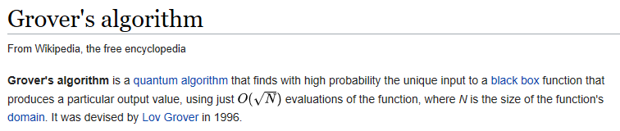
Grover‘s algorithm
https://en.wikipedia.org/wiki/Grover%27s_algorithm

Slide 27
Grover‘s algorithm

Slide 28
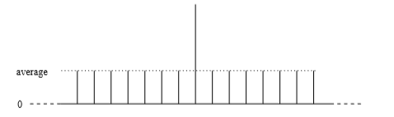
Grover algorithm
With a quantum computer, we can (in a sense) calculate a function for all possible inputs in one sweep. However… this is quite useless, because we can only measure one result.
One idea is… “amplify” the desired result, so that when we measure, we have a good likelihood to measure the desired result.
Prepare a register to contain a superposition of all possible inputs x_{i} ∈ [0...2^{n−1}]
Compute P(x_{i}) on this register Oracle function P is 1 if it is a good state, and 0 otherwise
Apply Grover‘s algorithm to the state which amplifies the „good state“ (but is a unitary transform!)
Repeat from (2) a certain number of time
Read the result
https://youtu.be/hK6BBluTGhU
https://arxiv.org/pdf/quant-ph/9809016.pdf sec. 7

Slide 29
Agenda
1
What is a Quantum Computer?
2
Q#
3
Grover‘s algorithm
4
4-bit adder
5
6
7
8

Slide 30
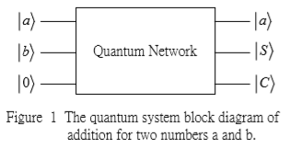
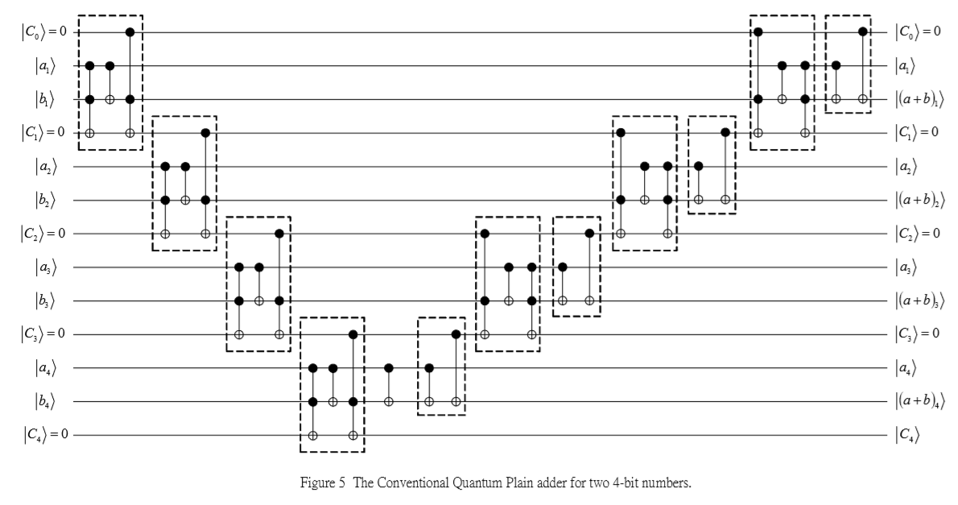
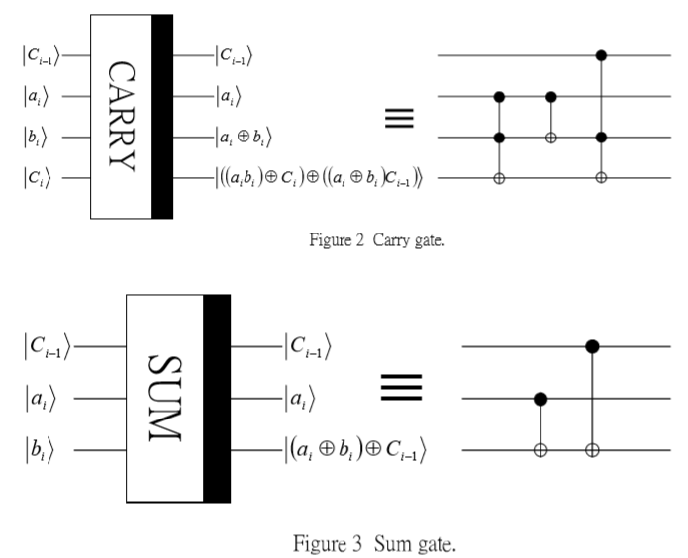
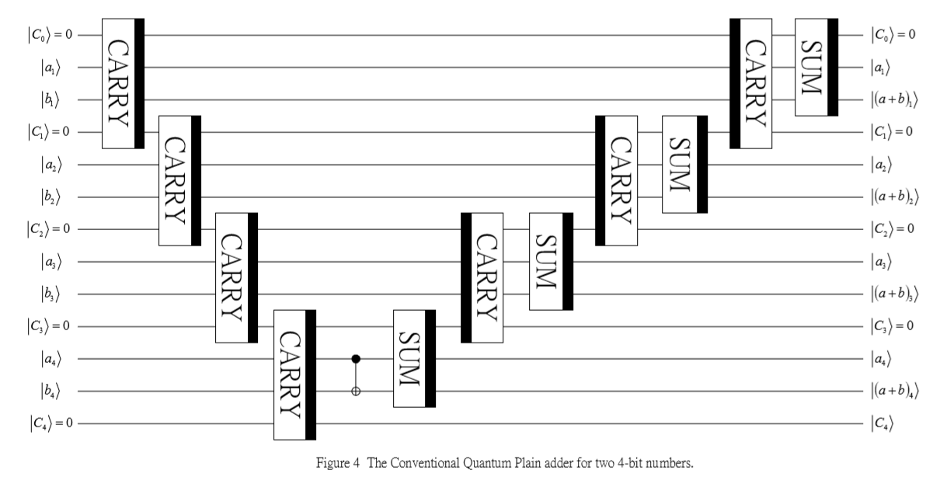
4-Bit adder
This adder ensures that the ancillary qubits (4 of them) are left in zero-state
https://arxiv.org/ftp/quant-ph/papers/0206/0206028.pdf

Slide 31
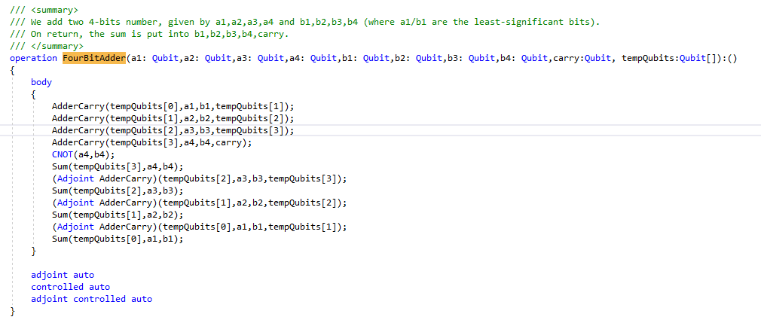
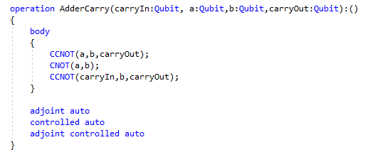
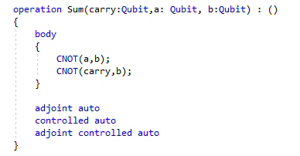
4-Bit Adder
https://github.com/ptahmose/QSharp-Playground

Slide 32
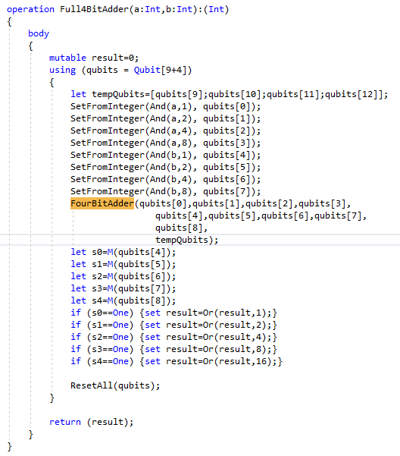
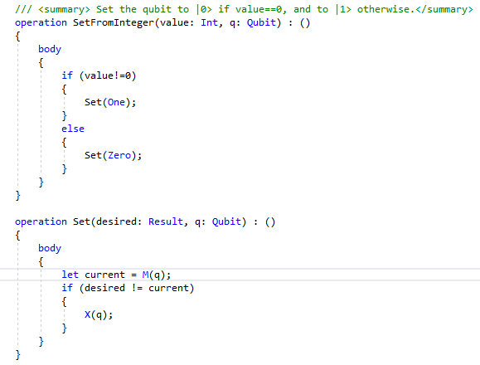
4-Bit Adder

Slide 33
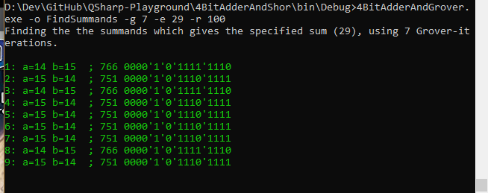

Slide 34
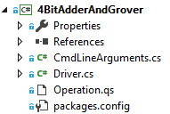
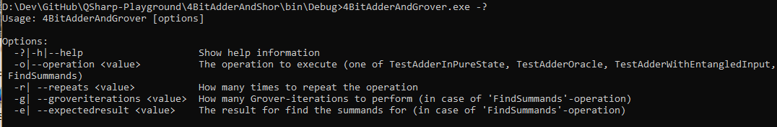
4-bit adder
Demo

Slide 35
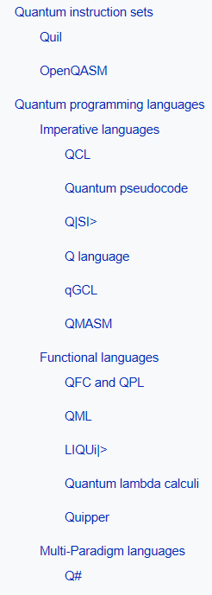
Other languages
https://en.m.wikipedia.org/wiki/Quantum_programming https://quantiki.org/wiki/quantum-programming-language
QCL http://tph.tuwien.ac.at/~oemer/qcl.html
LanQ http://lanq.sourceforge.net/

Slide 36
SPARE

Slide 37
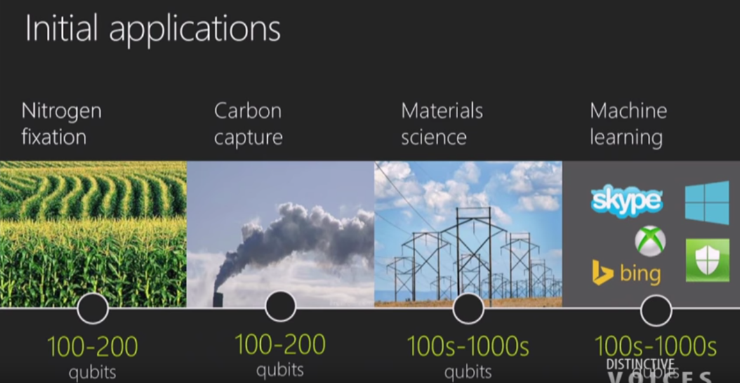

Slide 38
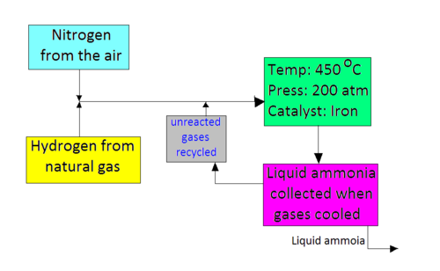
Nitrogen fixation
Haber-Bosch process (1909)
For production of fertilizers (500 Mio tons per year)
Haber-Bosch process uses a lot of enery (≈5% of world natural gas production)
Surely there is a better way (as seen in plants and microbes)
→ the hope/claim is that ≈100-200 qubits would help designing new catalysts
Same for carbon capture for obvious reasons, however this problem is assumed to be harder (200-400 qubits)

Slide 39


Slide 40


Slide 41


Slide 42

MS Ignite 2017 Conference (sep 25)
Microsoft presents Quantum Computer within MSIgnite 2017 on September 25, 2017. Microsoft’s CEO Satya Nadella announced new Microsoft Cloud Computing Platform and Quantum Computer from Microsoft!
https://www.youtube.com/watch?v=IFZt3xds74A&t=570s

Slide 43

Shor‘s algorithm
Shor's algorithm is a quantum algorithm for factoring a number N in O((logN)3) time and O(logN) space, named after Peter Shor.

Slide 44

Shor‘s algorithm

Slide 45

Quantum Error Correction

Slide 46

https://www.youtube.com/watch?v=4mMizLpIVKs

Slide 47

https://quantumexperience.ng.bluemix.net/qx/experience

Slide 48


Slide 49


